Slide 1
Classification
Dr. Mehmet Yasin Ulukuş

Slide 2
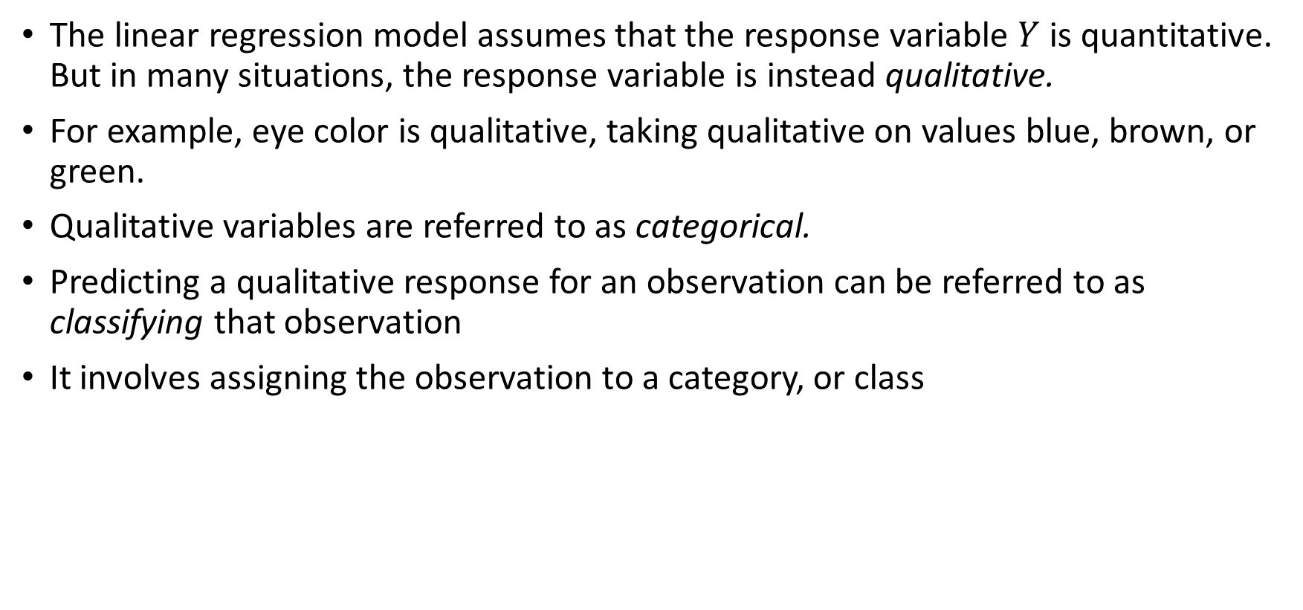
Classification
The linear regression model assumes that the response variable $Y$ is quantitative. But in many situations, the response variable is instead qualitative.
For example, eye color is qualitative, taking qualitative on values blue, brown, or green.
Qualitative variables are referred to as categorical.
Predicting a qualitative response for an observation can be referred to as classifying that observation
It involves assigning the observation to a category, or class

Slide 3
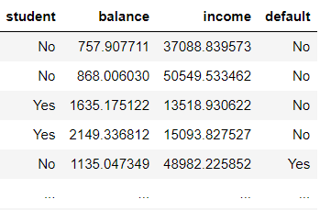
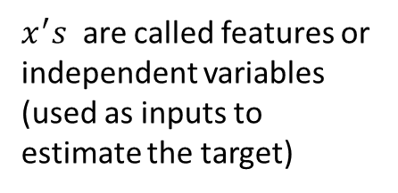
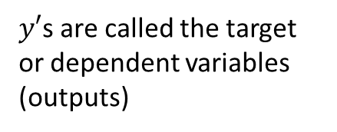
Classification
Classification problems occur perhaps more than regression.
Examples:
Given a patient’s medical history, predict Cancer or Not Cancer
Given shopping habits, predict social status
Given a picture of a person, decide if she is happy or not happy
Given an email text, decide spam or no spam
Just as in the regression setting, we have a set of training observations to learn from to build a classifier
$x^{′}s$ are called features or independent variables (used as inputs to estimate the target)
$y′$s are called the target or dependent variables (outputs)

Slide 4
Classification
There are many possible classification techniques, or classifiers.
Often the methods used for classification first predict the probability of each of the categories of a qualitative variable, as the basis for making the classification
We will discuss three of the most widely-used classifiers: logistic regression, Naive Bayes and K-nearest neighbors.
We will discuss more computer-intensive methods in later chapters, such as Decision Trees, Random Forests etc.

Slide 5
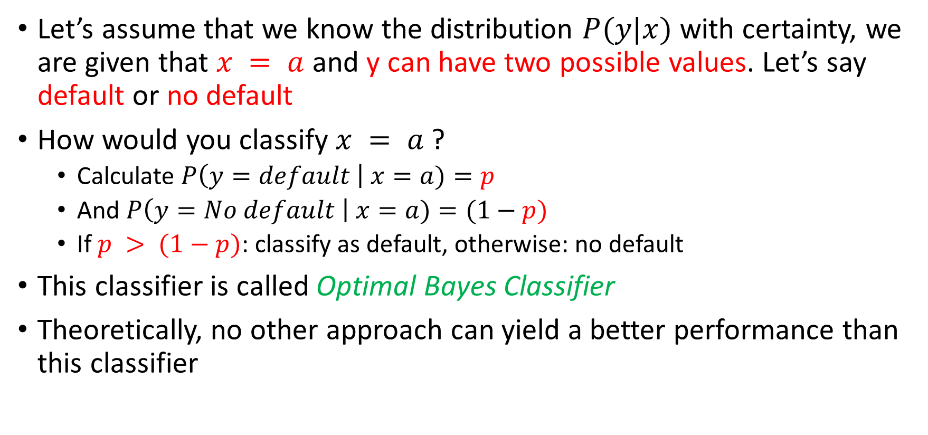
Optimal Bayes Classifier
Let’s assume that we know the distribution $P(y|x)$ with certainty, we are given that $x = a$ and y can have two possible values. Let’s say default or no default
How would you classify $x = a$ ?
Calculate $P\left(y=default \right| x=a)=p$
And $P\left(y=No default \right| x=a)=(1−p)$
If $p > (1−p)$: classify as default, otherwise: no default
This classifier is called Optimal Bayes Classifier
Theoretically, no other approach can yield a better performance than this classifier

Slide 6
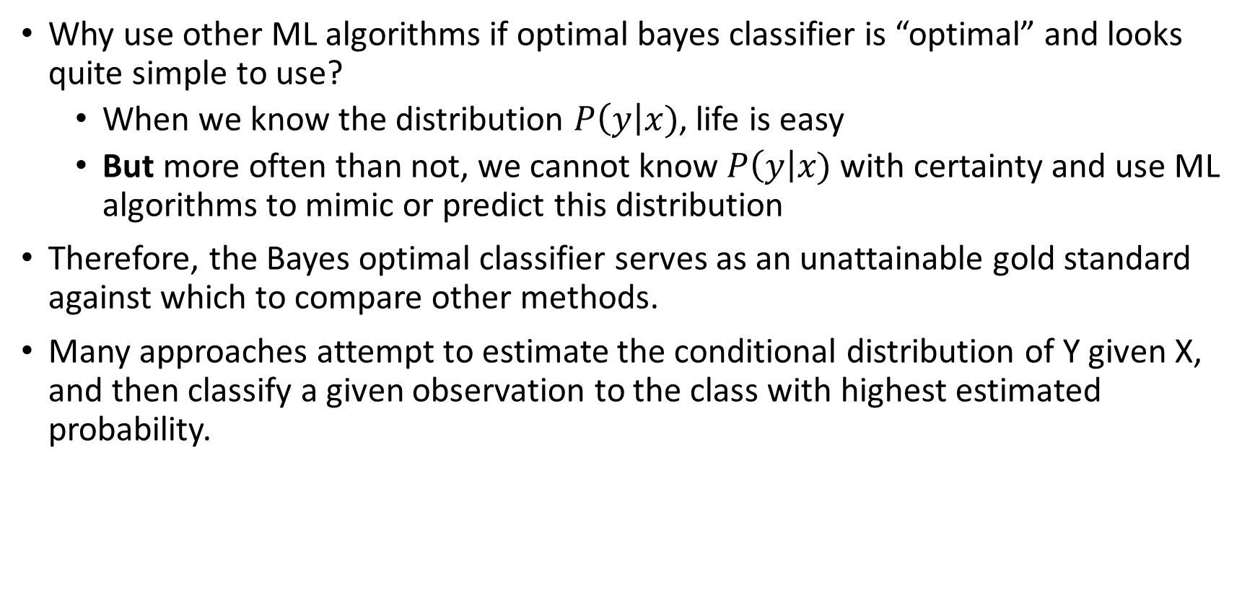
A big but…
Why use other ML algorithms if optimal bayes classifier is “optimal” and looks quite simple to use?
When we know the distribution $P\left(y\right|x)$, life is easy
But more often than not, we cannot know $P\left(y\right|x)$ with certainty and use ML algorithms to mimic or predict this distribution
Therefore, the Bayes optimal classifier serves as an unattainable gold standard against which to compare other methods.
Many approaches attempt to estimate the conditional distribution of Y given X, and then classify a given observation to the class with highest estimated probability.

Slide 7
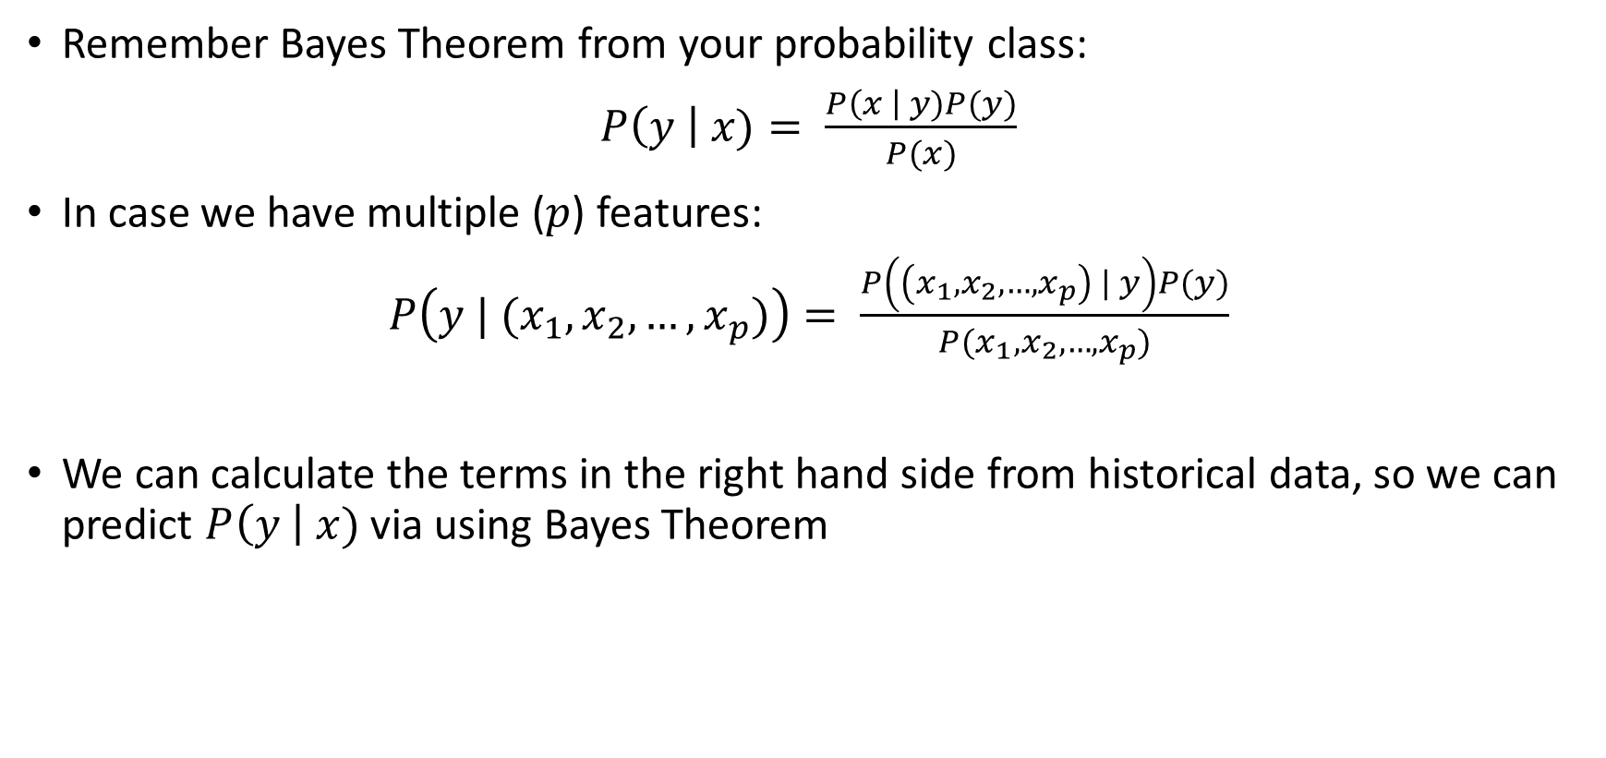
Use of the Bayes Theorem
Remember Bayes Theorem from your probability class:
$P\left(y \right| x)= \frac{P\left(x \right| y)P(y)}{P(x)}$
In case we have multiple ($p$) features:
$P\left(y | (x_{1},x_{2}, …, x_{p})\right)= \frac{P\left(\left(x_{1},x_{2}, …, x_{p}\right) | y\right)P(y)}{P(x_{1},x_{2}, …, x_{p})}$
We can calculate the terms in the right hand side from historical data, so we can predict $P\left(y \right| x)$ via using Bayes Theorem

Slide 8
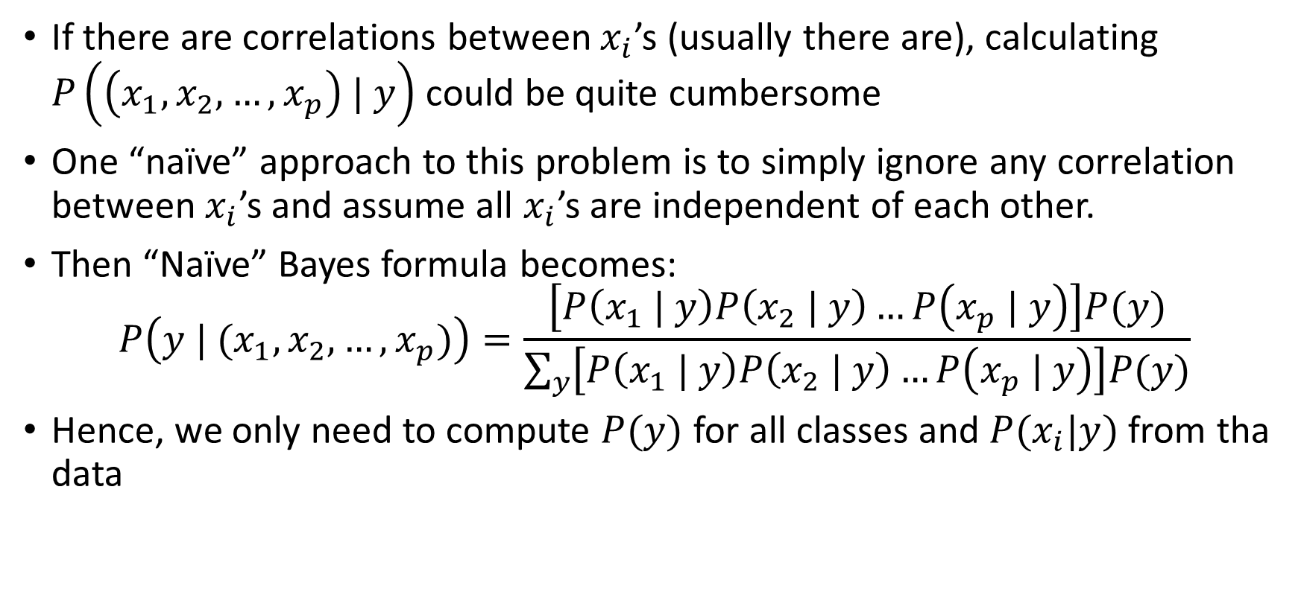
Naïve Bayes Method
If there are correlations between $x_{i}$’s (usually there are), calculating $P\left(\left(x_{1},x_{2}, …, x_{p}\right) | y\right)$ could be quite cumbersome
One “naïve” approach to this problem is to simply ignore any correlation between $x_{i}$’s and assume all $x_{i}$’s are independent of each other.
Then “Naïve” Bayes formula becomes:
$$P\left(y | (x_{1},x_{2}, …, x_{p})\right)=\frac{\left[P\left(x_{1} | y\right)P\left(x_{2} | y\right)…P\left(x_{p} | y\right)\right]P(y)}{\sum_{y}{\left[P\left(x_{1} | y\right)P\left(x_{2} | y\right)…P\left(x_{p} | y\right)\right]P(y)}}$$
Hence, we only need to compute $P(y)$ for all classes and $P(x_{i}|y)$ from tha data

Slide 9
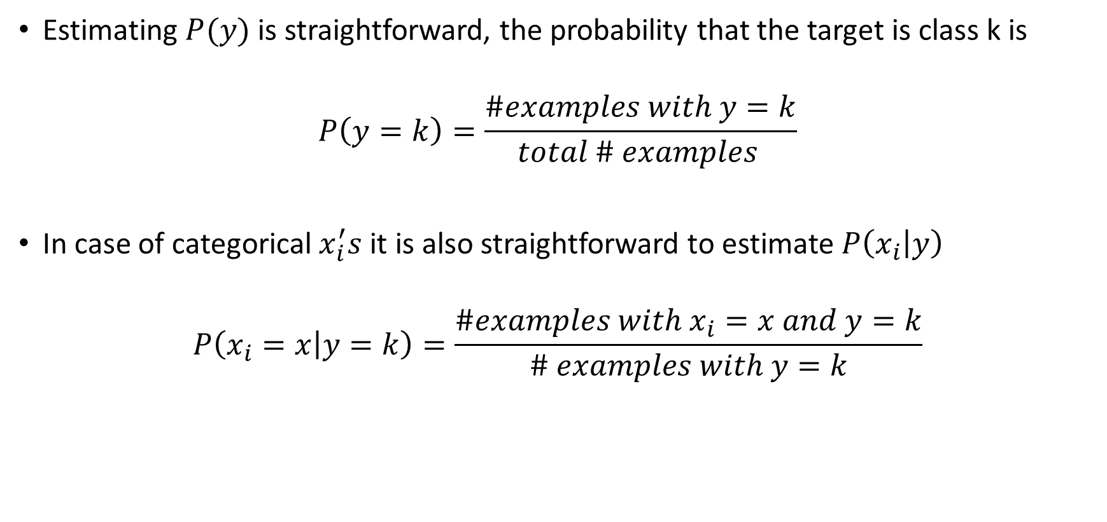
Estimating Probabilities from Data
Estimating $P(y)$ is straightforward, the probability that the target is class k is
$$P\left(y=k\right)=\frac{\#examples with y=k}{total \# examples }$$
In case of categorical $x_{i}^{′}s$ it is also straightforward to estimate $P\left(x_{i} | y\right)$
$$P\left(x_{i}=x | y=k\right)=\frac{\#examples with x_{i}=x and y=k}{\# examples with y=k}$$

Slide 10
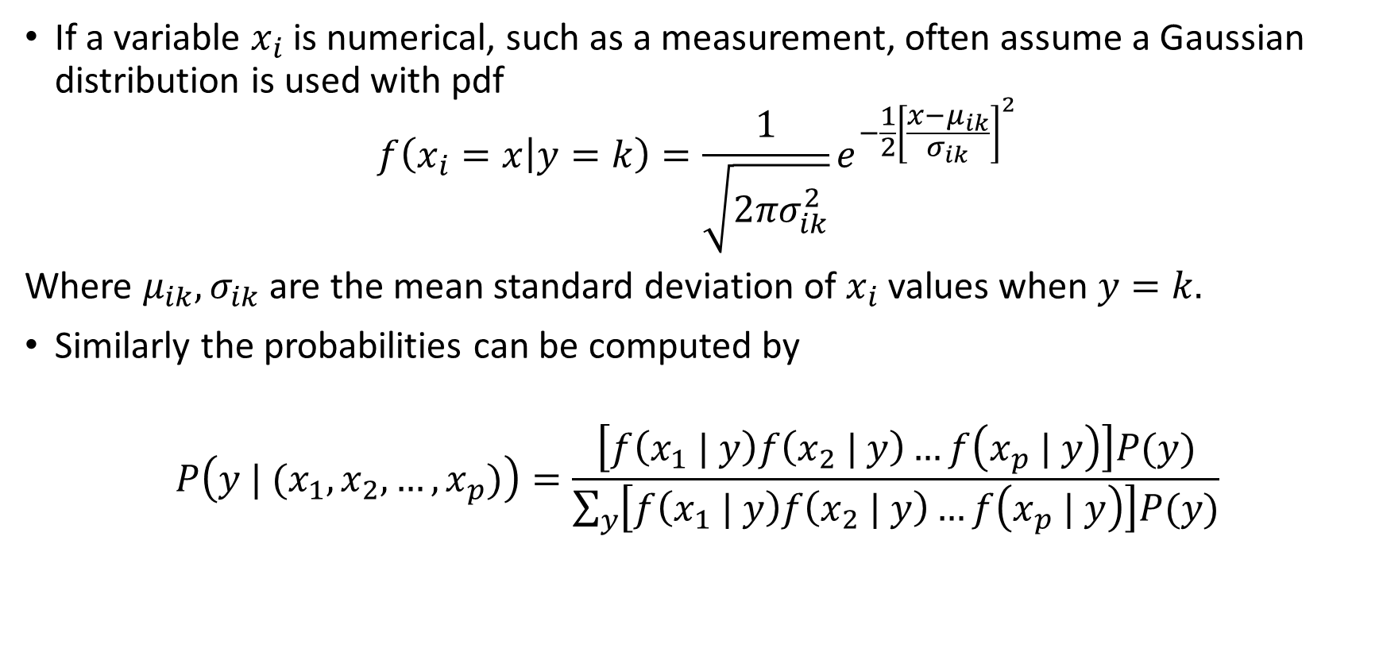
Estimating Probabilities from Data
If a variable $x_{i}$ is numerical, such as a measurement, often assume a Gaussian distribution is used with pdf
$$f\left(x_{i}=x | y=k\right)=\frac{1}{\sqrt{2πσ_{ik}^{2}}}e^{−\frac{1}{2}{\left[\frac{x−μ_{ik}}{σ_{ik}}\right]}^{2}}$$
Where $μ_{ik},σ_{ik}$ are the mean standard deviation of $x_{i}$ values when $y=k.$
Similarly the probabilities can be computed by
$$P\left(y | (x_{1},x_{2}, …, x_{p})\right)=\frac{\left[f\left(x_{1} | y\right)f\left(x_{2} | y\right)…f\left(x_{p} | y\right)\right]P(y)}{\sum_{y}{\left[f\left(x_{1} | y\right)f\left(x_{2} | y\right)…f\left(x_{p} | y\right)\right]P(y)}}$$

Slide 11
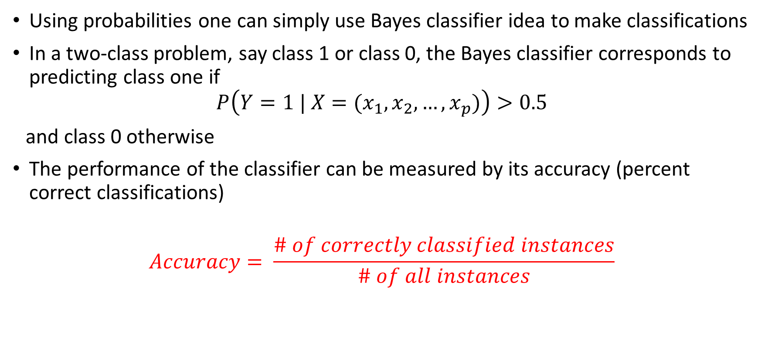
Performance Metric
Using probabilities one can simply use Bayes classifier idea to make classifications
In a two-class problem, say class 1 or class 0, the Bayes classifier corresponds to predicting class one if
$$P\left(Y=1 | X=(x_{1},x_{2}, …, x_{p})\right)>0.5$$
and class 0 otherwise
The performance of the classifier can be measured by its accuracy (percent correct classifications)
$$Accuracy= \frac{\# of correctly classified instances}{\# of all instances}$$

Slide 12
Training and Test
Our objective is to use the classifier in real life (on the instances that the algorithm has not seen when trained)
The performance of the algorithm on the training set is biased. In the final exam, if I ask you exactly the same questions I solved in the class, the students that simply memorized them will be very successful. This does not mean that they have learned the concept really well.
Generally, we do not have a test data preserved somewhere else to do this check.
One way to deal with this issue is to randomly split the data into a training set, and test set (generally 80% to 20%, not always).
We fit our model using training set and test the performance on test set.
Training Data (80%)
Test Data (20%)

Slide 13
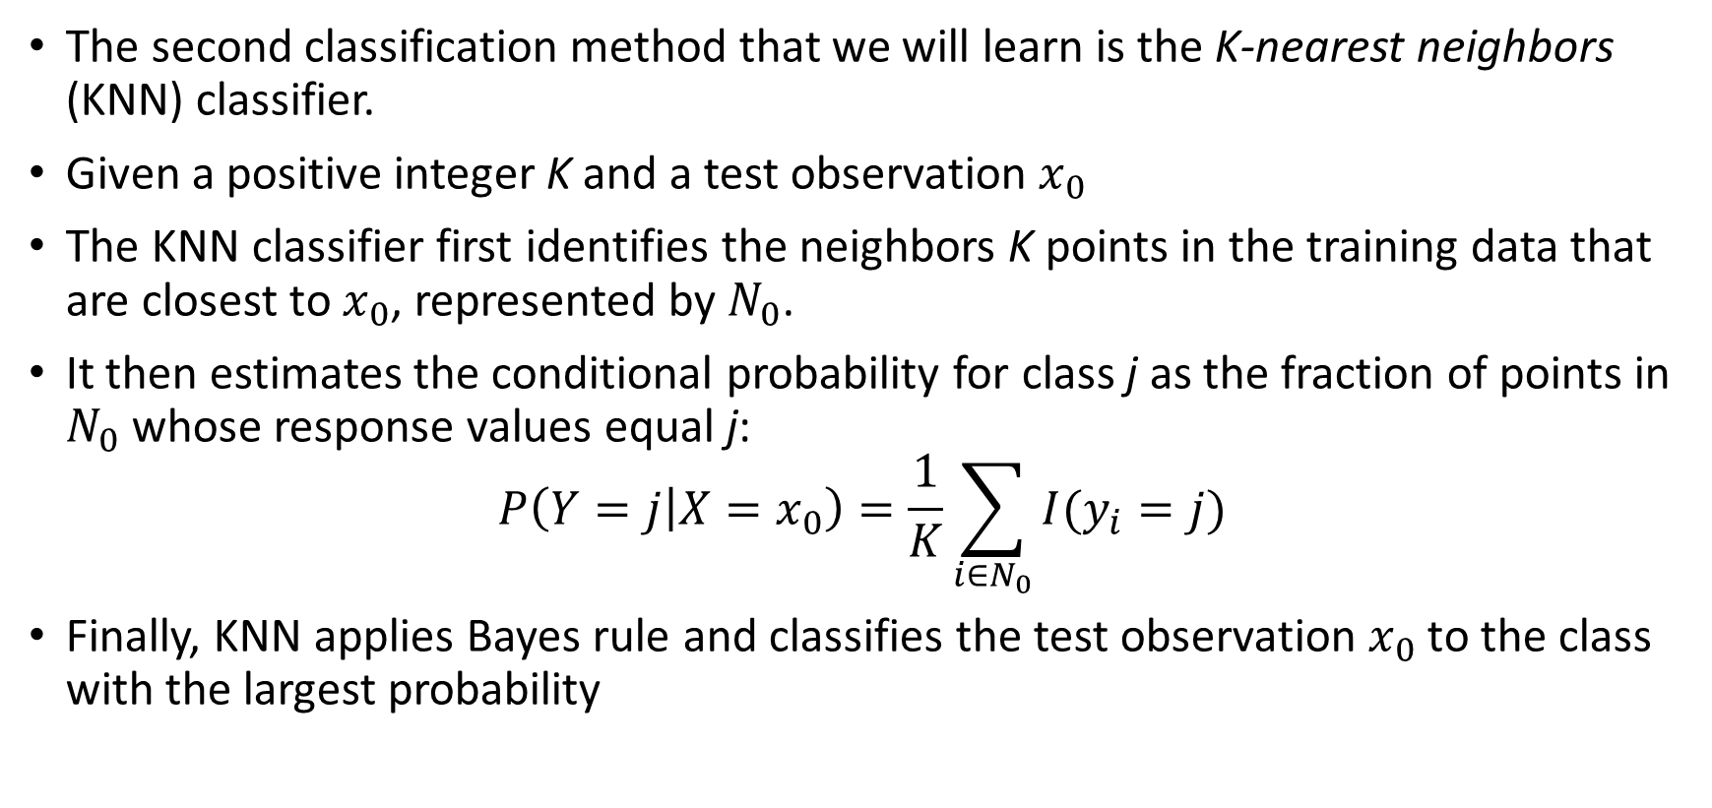
K-Nearest Neighbors
The second classification method that we will learn is the K-nearest neighbors (KNN) classifier.
Given a positive integer K and a test observation $x_{0}$
The KNN classifier first identifies the neighbors K points in the training data that are closest to $x_{0}$, represented by $N_{0}$.
It then estimates the conditional probability for class j as the fraction of points in $N_{0}$ whose response values equal j:
$$P\left(Y=j | X=x_{0}\right)=\frac{1}{K}\sum_{i∈N_{0}}{I(y_{i}=j)}$$
Finally, KNN applies Bayes rule and classifies the test observation $x_{0}$ to the class with the largest probability

Slide 14
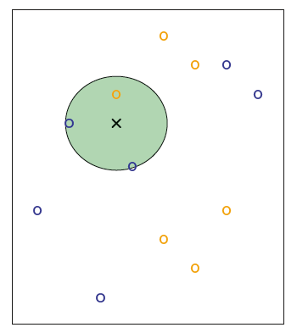
K-Nearest Neighbors
We have small training data set consisting of six blue and six orange observations
Goal is to make a prediction for the point labeled by the black cross.
Suppose that we choose K = 3.
Then KNN will first identify the three observations that are closest to the cross. Neighborhood is shown as a circle.
It consists of two blue points and one orange point, resulting in estimated probabilities of 2/3 for the blue class and 1/3 for the orange class.
Hence KNN will predict that the black cross belongs to the blue class.

Slide 15
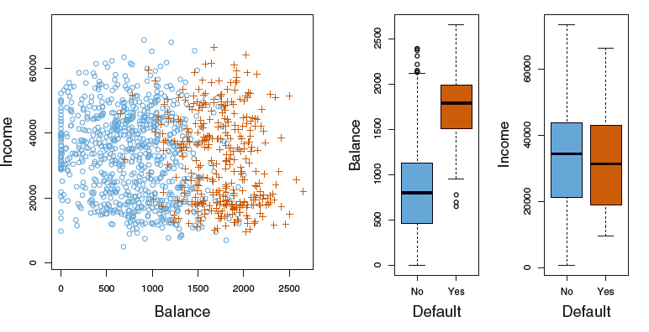
Classification
We are interested in predicting whether an individual will default on his or her credit card payment, on the basis of annual income and monthly credit card balance
The response default $Y$ falls into one of two categories, Yes or No

Slide 16
Decision Boundary
Decision Boundaries

